Slide 1

Android Security: Malicious APKs

Slide 2
Hello!
I am Pranav Chachara
Ethical Hacking Director | HW Tech Club

Slide 3
What are APKs?
Let’s start with the first set of slides

Slide 4

What are APKs?
Let’s start with the first set of slides

Slide 5
How are APKs made?
🔨

Slide 6
The APK workflow basics
🔨
Let’s start with the first set of slides

Slide 7
The APK workflow basics
Setup
🔨
Let’s start with the first set of slides

Slide 8
The APK workflow basics
Setup
Write
🔨
Let’s start with the first set of slides

Slide 9
The APK workflow basics
Setup
Write
Build & Run
🔨
Let’s start with the first set of slides

Slide 10
The APK workflow basics
Setup
Write
Build & Run
Iterate
🔨
Let’s start with the first set of slides

Slide 11
The APK workflow basics
Setup
Write
Build & Run
Iterate
Publish
🔨
Let’s start with the first set of slides

Slide 12

Exploitation

Slide 13
Decompile APK

Slide 14
Decompile APK
Generate & Decompile Payload

Slide 15
Decompile APK
Inject Payload
Generate & Decompile Payload

Slide 16
Decompile APK
Inject Payload
Change Permissions & StubApp
Generate & Decompile Payload

Slide 17
Decompile APK
Inject Payload
Change Permissions & StubApp
Generate & Decompile Payload
Build APK

Slide 18
Decompile APK
Inject Payload
Change Permissions & StubApp
Generate & Decompile Payload
Build APK
Generate Key &
Sign APK

Slide 19
Decompile APK
Inject Payload
Change Permissions & StubApp
Generate & Decompile Payload
Build APK
Generate Key &
Sign APK
Zipalign APK

Slide 20
Decompile APK
Inject Payload
Change Permissions & StubApp
Generate & Decompile Payload
Send APK & Listen for callback
Build APK
Generate Key &
Sign APK
Zipalign APK

Slide 21

Live Hack

Slide 22
Pre-recorded Hack

Slide 23
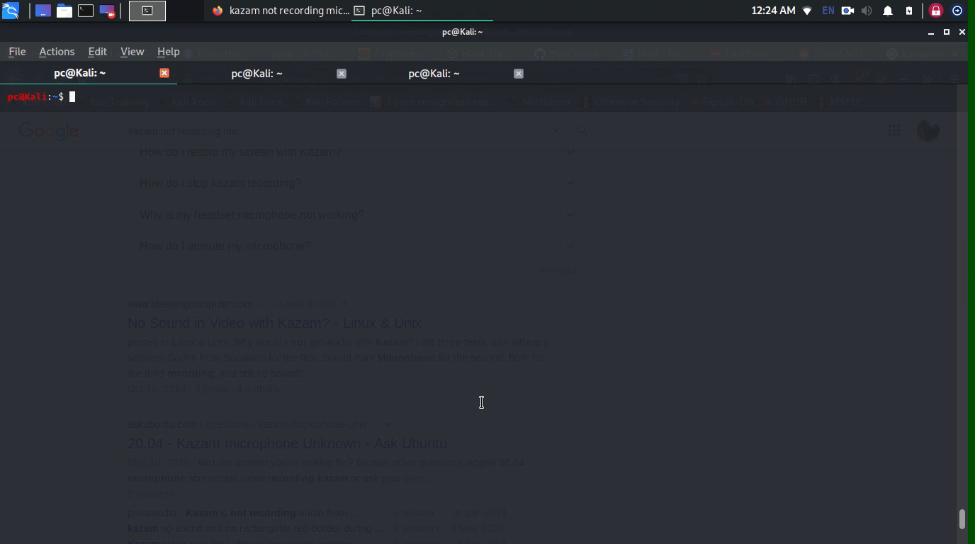

Slide 24

Prevention

Slide 25


Slide 26

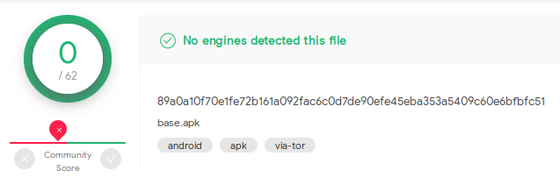

Slide 27
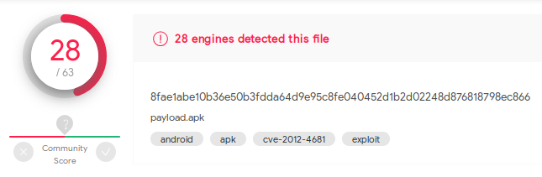

Slide 28

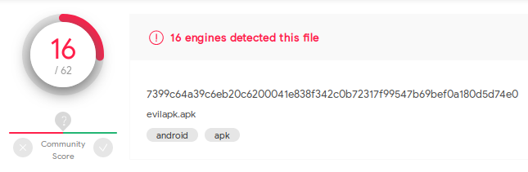

Slide 29
ASTAN –
App Analyzer

Slide 30

Summary

Slide 31
Thanks!
Any questions?
You can find me at:
pc59@hw.ac.uk
pranav@hwtech.club

Slide 32
Credits
Special thanks to all the people who made and released these awesome resources for free:
Presentation template by SlidesCarnival
Photographs by Unsplash
Illustrations by Undraw.co

